Slide 1
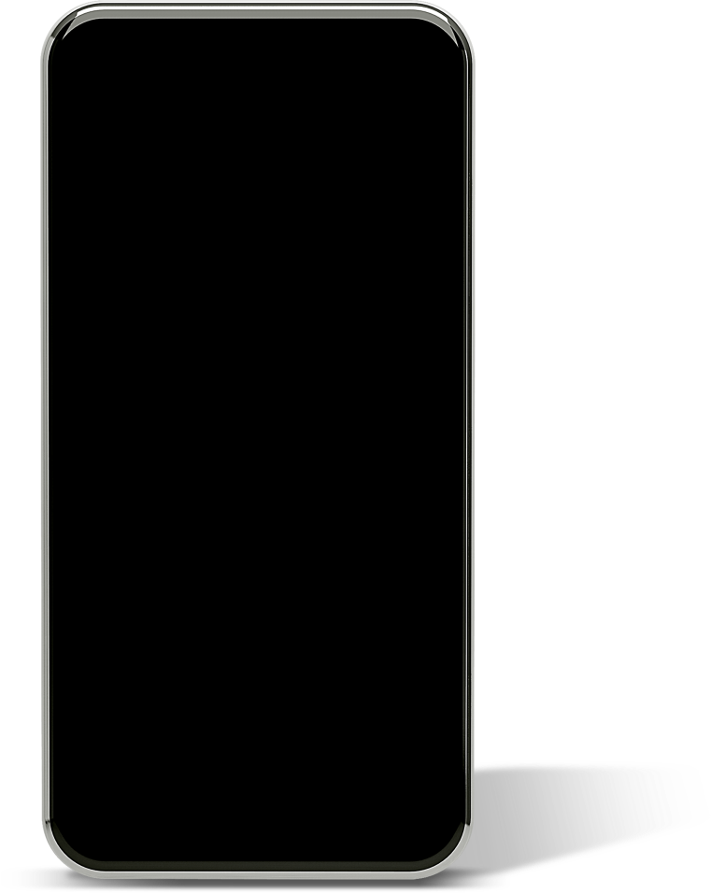














Weekly Progress, Oct 11st, 2024
Housit- hows it?
:HouseCare Mobile Application
Team A : A+
Minsoo KIM, Seoyoung JO, Seoyoung JIN,
Jinwook CHOI, Sooyoung HWANG

Slide 2
Index
01 Role & Action Plan
02 What has been done & by whom this week?
02-01 Designing UX/UI and workflow of the application
Specifying the features of app
Designing/fixing UX/UI
Designing prototype of app with Figma
02-02 Frontend & Backend preparation & set-up
Designing ERD(Entity Relationship Diagram)
API documentation
02-03 OCR Feature Implementation
Technical Background
03 What will be done & by whom next week?

Slide 3
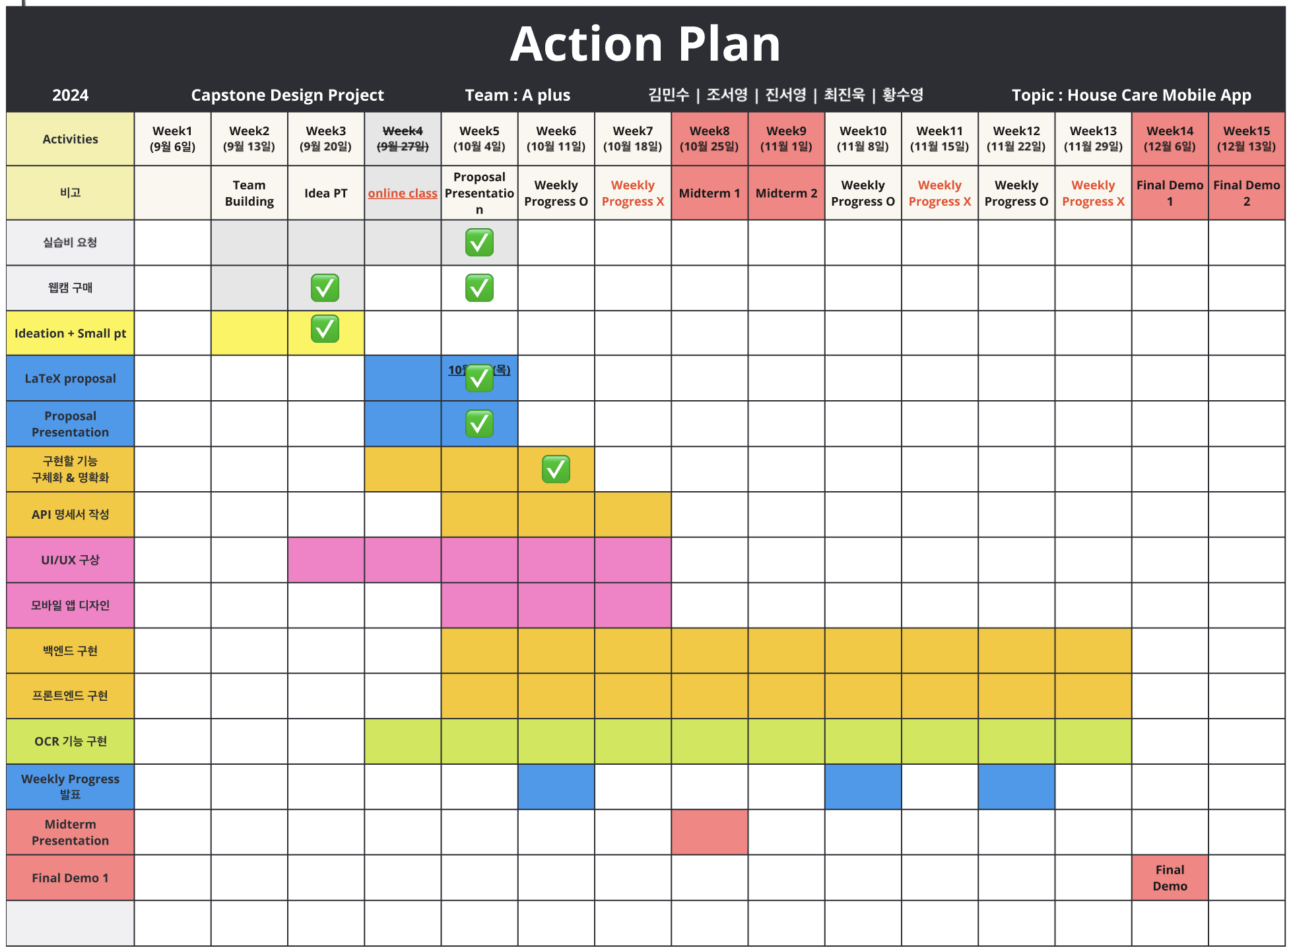
01 Role & Action Plan
Name | Role
김민수 | Planning, Document, UI/UX
조서영 | OCR Feature Implementation
진서영 | UI/UX Design
최진욱 | Frontend
황수영
Backend

Slide 4
02 What has been done
& by whom this week?
Designing UX/UI and workflow of the application
Specifying the features of app @김민수
Designing/fixing UX/UI @김민수 @진서영
Designing prototype of app with Figma @진서영
Frontend & Backend preparation & set-up
Designing ERD(Entity Relationship Diagram) @황수영
API documentation @황수영 @최진욱 @김민수
Basic setup(Frontend) @최진욱
OCR Feature Implementation @조서영
Architecture configuration of how to implement OCR functionality
Buying a IP camera

Slide 5
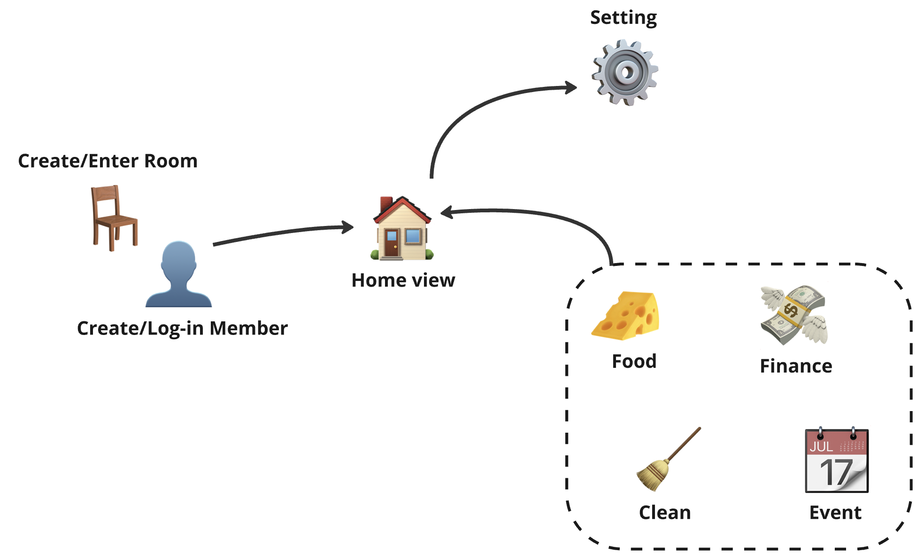
02-02 Main features of our app

Slide 6
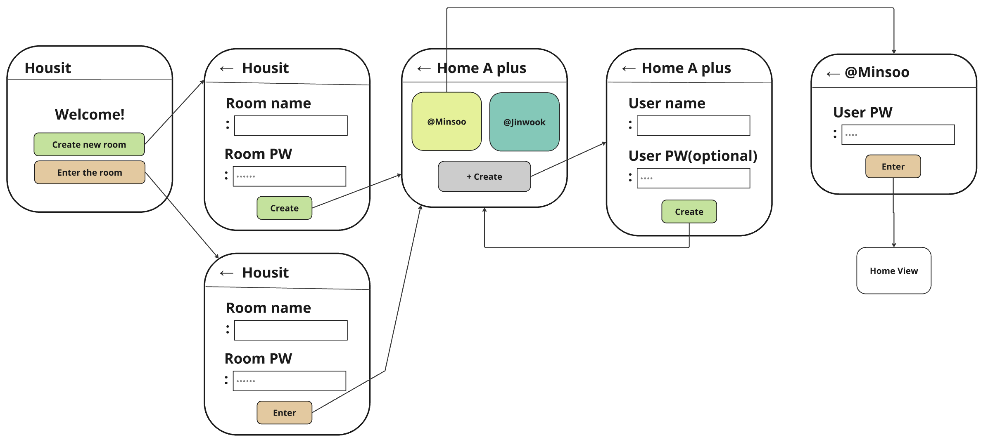
Feature Details : Room/User
Features to Implement
Create a Room
Join a Room
Create user
User entry
Challenge
If there are many similar room IDs, how can we help users accurately find the correct ID? If users forget their ID or password, how can we implement a recovery feature?

Slide 7
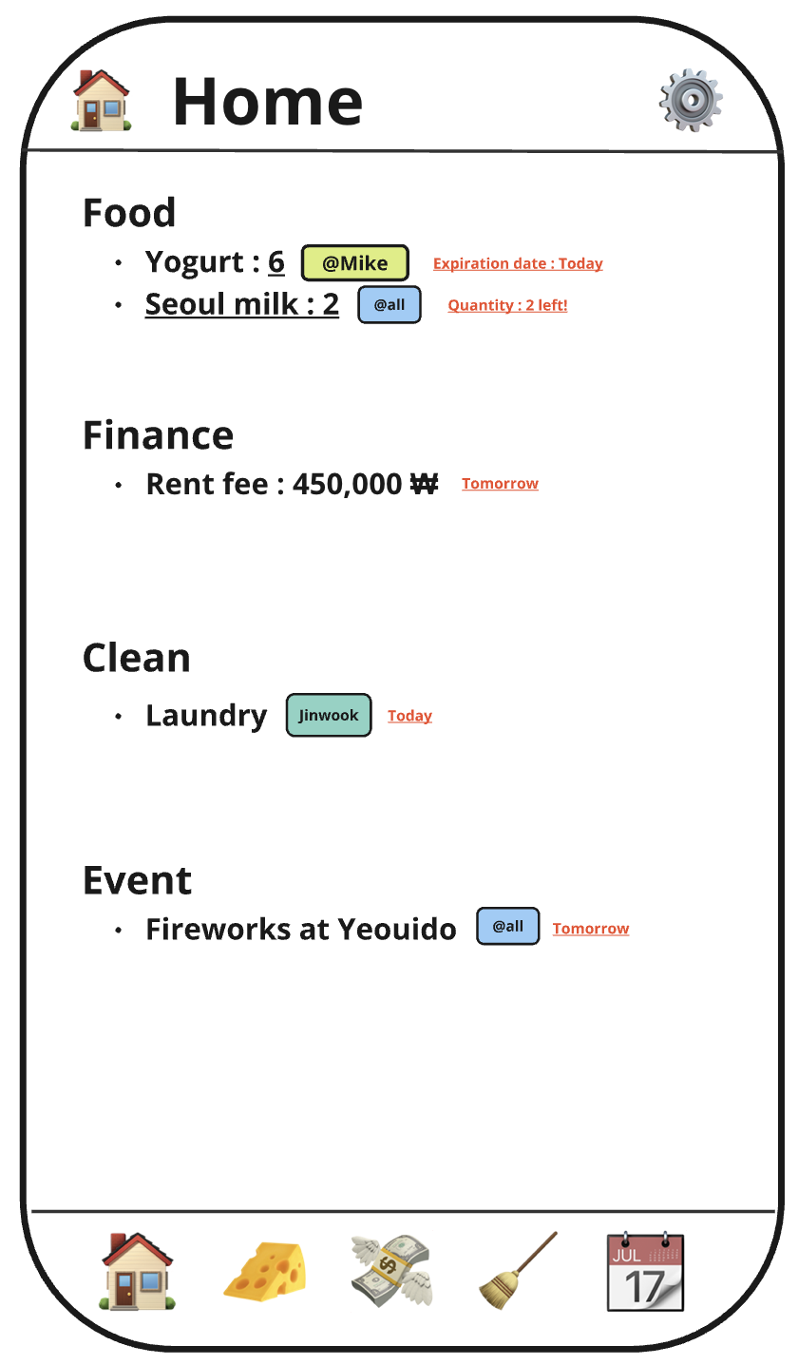
Feature Details : Home
Features to Implement
Information to Retrieve from Food:
01. Food items nearing expiration
02. Favorite foods falling below a set quantity
Information to Retrieve from Finance: Upcoming expenses with approaching due dates
Information to Retrieve from Clean: Approaching cleaning tasks with assigned areas
Information to Retrieve from Event: Approaching shared events
Challenge to discuss
When displaying upcoming information from Food, Finance, Clean, and Event, it would be helpful to allow users to set a notification for ‘N days before’ in addition to just ‘on the day’.

Slide 8
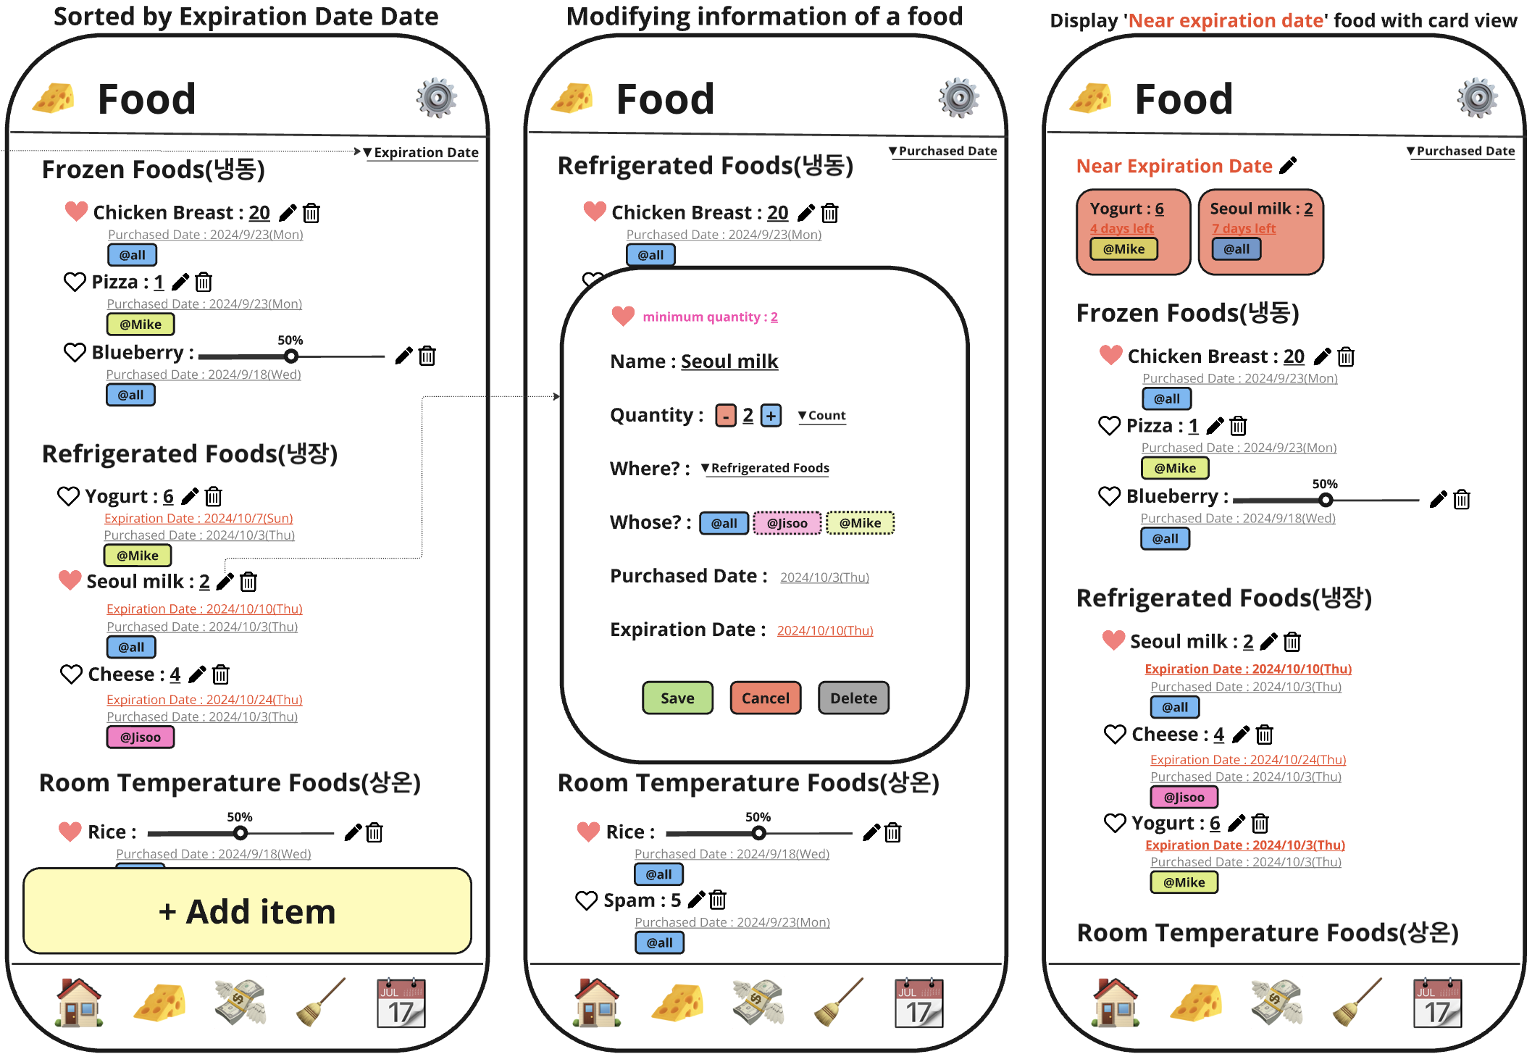
Feature Details : Food
구현할 기능
View
Grouping
Default grouping by categories: Refrigerated/Frozen/Room Temperature
Group by food owner
Group by favorite foods
Filtering
Display only favorite foods
Sorting
By expiration date (soonest first)
By purchase date (oldest first)
Highlight foods nearing expiration at the top
Add/Modify/Delete Grocery Items
Quantity display: by item count or percentage
Tags for Shared or Personal food items
Shared "like" feature for foods
Notification when the quantity drops below the set minimum
Challenge
None

Slide 9
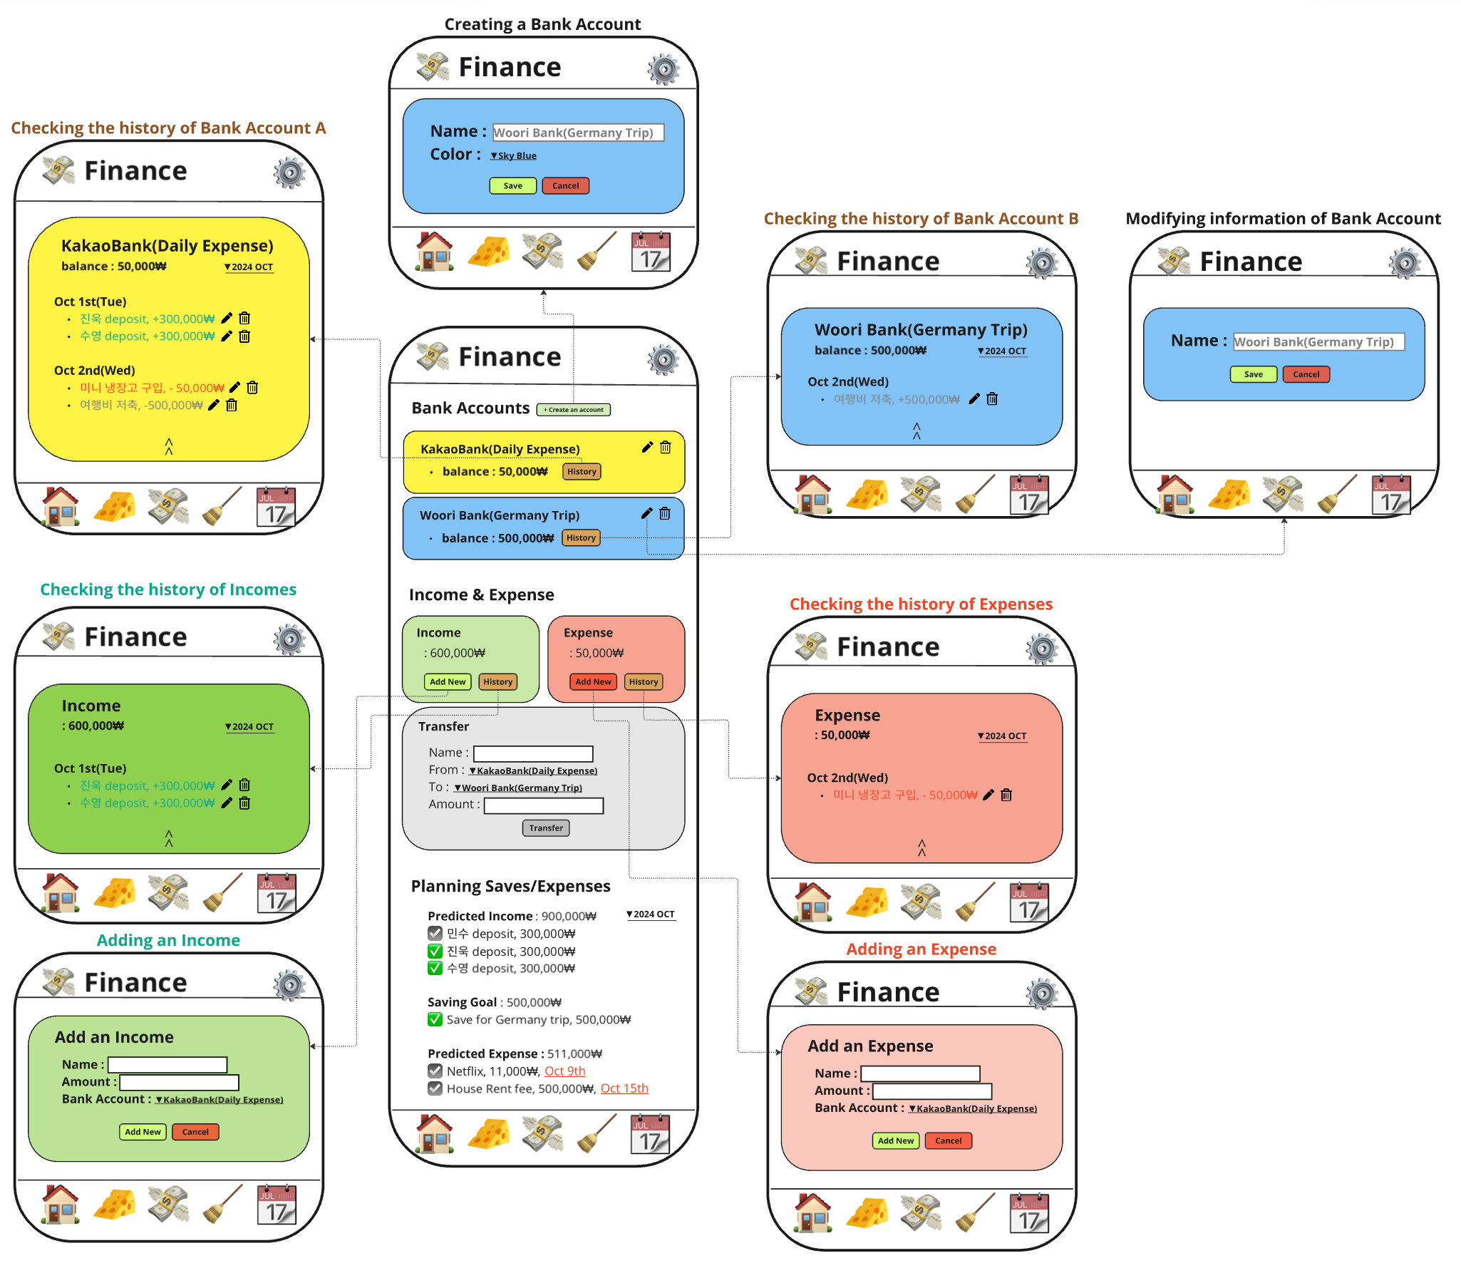
Feature Details : Finance
Features to Implement
Account Balance Overview
Create/Edit/Delete accounts
Monthly Overview of Income/Expenses/Transfers
Track and review all income, expenses, and transfers
Transaction create/edit/delete
View monthly totals and details of income and expenses
Planned Income/Expenses/Saving
Set up with checkboxes, names, amounts, and expected dates
Challenge
Need a color assignment feature per account, considering a preset palette or custom color (e.g., #FFFFFF).
Displaying planned income/expenses/savings as a list view. Due to limited space, a bulk edit and save approach may be more user-friendly than adding edit buttons for each item.
Consider combining and simplifying buttons for tracking income/expenses/transfers.
High number of modals makes the UI feel cluttered—explore alternative UI/UX designs, such as using a bottom sheet.

Slide 10
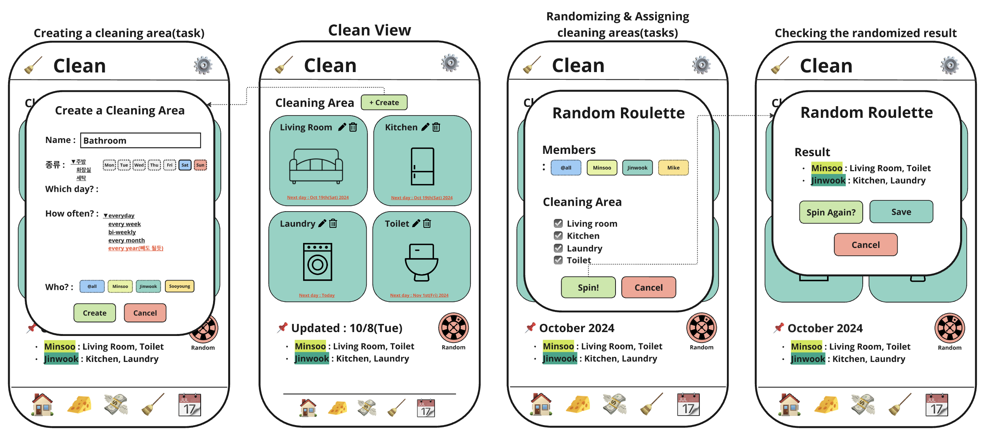
Feature Details : Clean
Features
Cleaning area make/modify/delete
Cleaning period & set day
Assign cleaning area manager
Challenge
Cleaning area card view pictogram -> Select 'Type' when creating/modifying cleaning area -> Image setting
Change the order of the cleaning area –> How to save after user interaction? -> Use modal?
Cleaning area random roulette
Select member, cleaning area & Spin

Slide 11
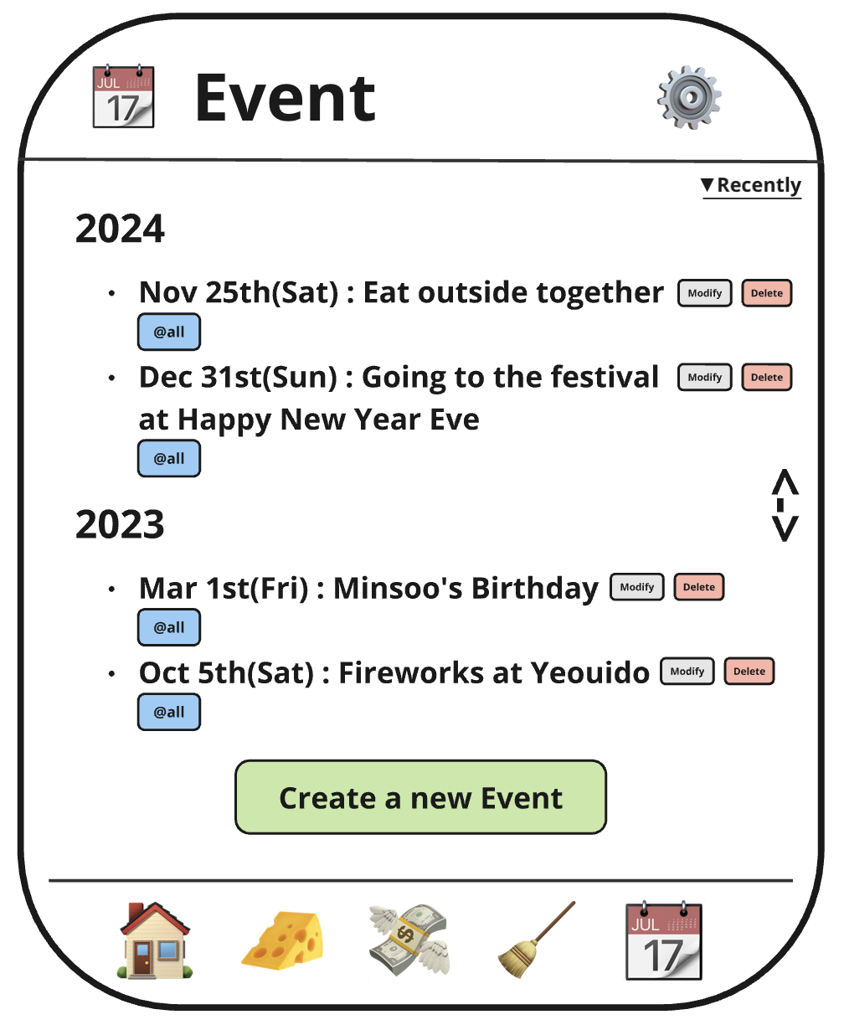
Feature Details : Event
Features to implement
Event Create/Modify/Delete
Display events (Future > Now > Past)
Challenge to discuss
If there are too many events, we don’t need to load events all at once -> Scroll down -> Be able to load more events by 3 months(1 quarter) Idea) Displaying (Past > Now > Future) Can we automatically show the current(now) point when the app opened?

Slide 12
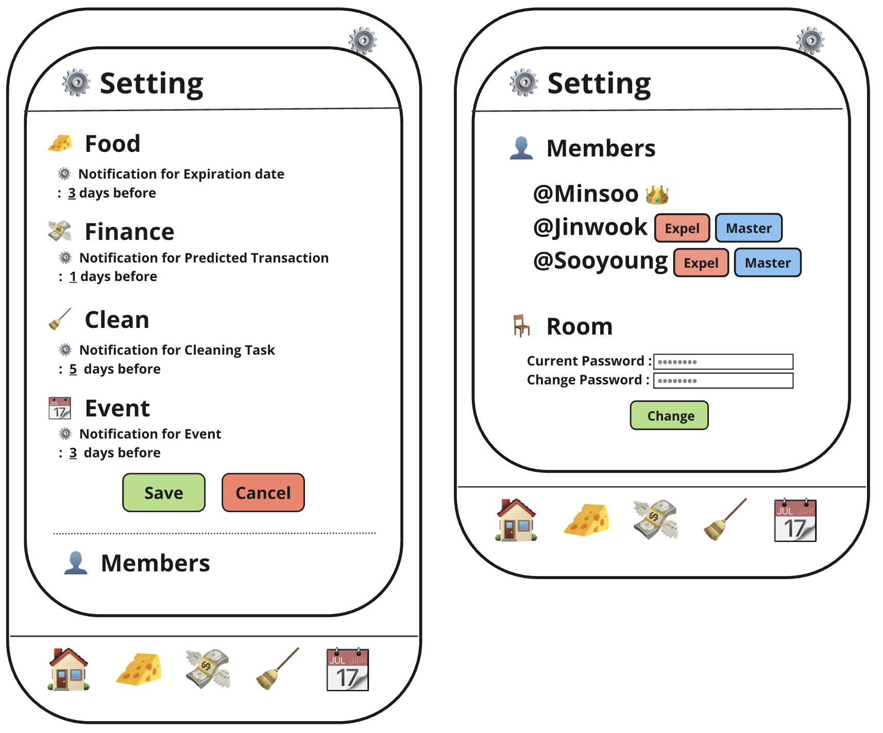
Feature Details : Setting
Features to implement
Setting notification ‘N days before’ of Food/Finance/Clean/Event
Banning(Expelling) strangers & Give “master” authority to the other member.
Change Room Password.
Challenge to discuss
When expelling a stranger, ask the master member mandatory PW change. -> How can we handle if the user quit the app during the changes.

Slide 13
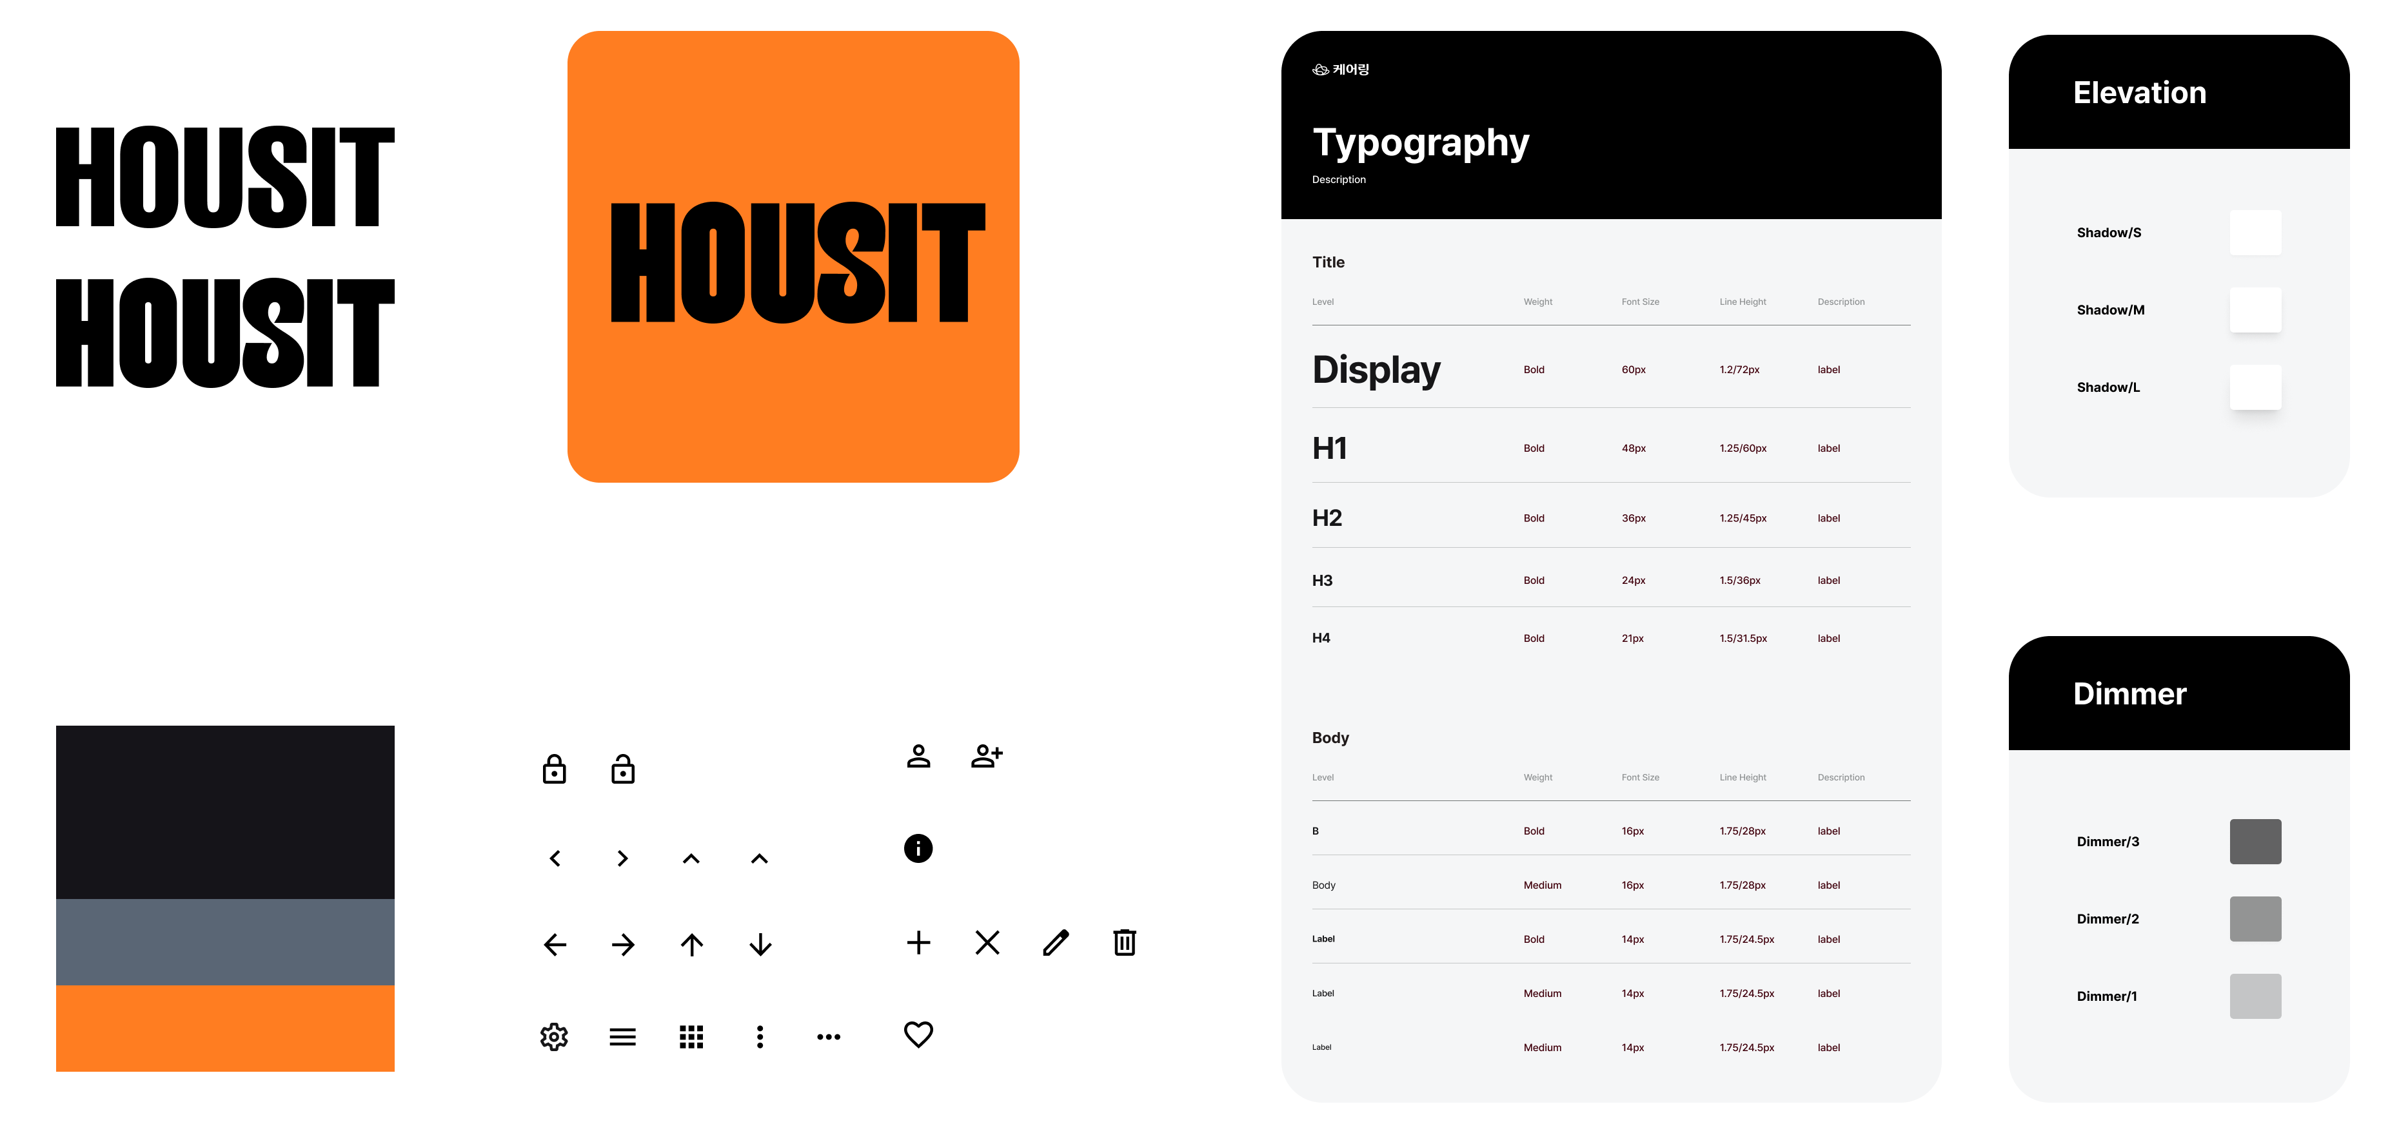
Prototype of app designed with Figma

Slide 14
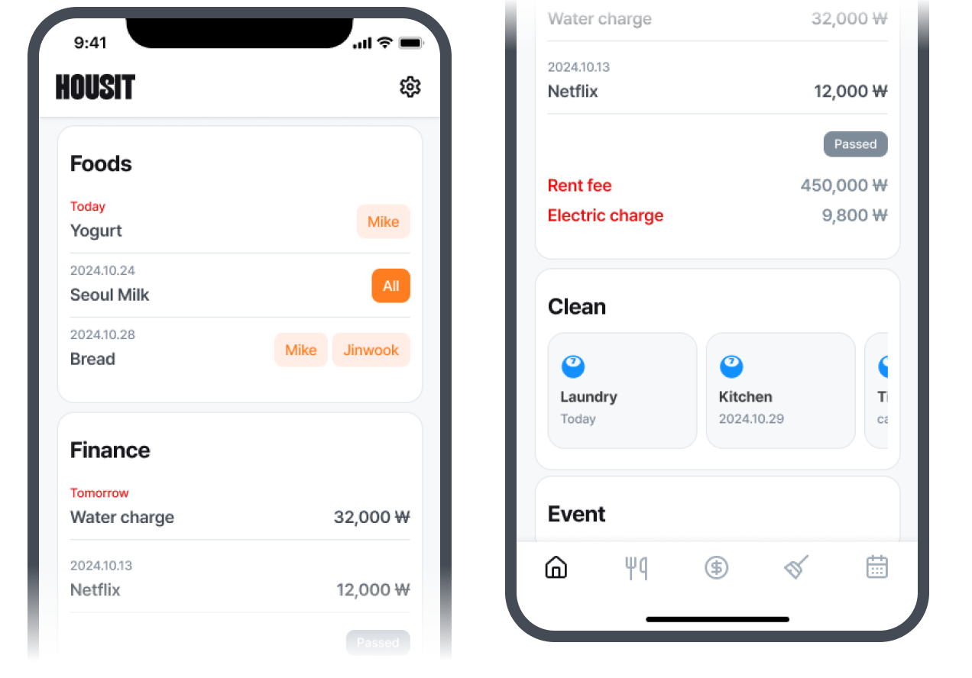
Prototype of app designed with Figma

Slide 15
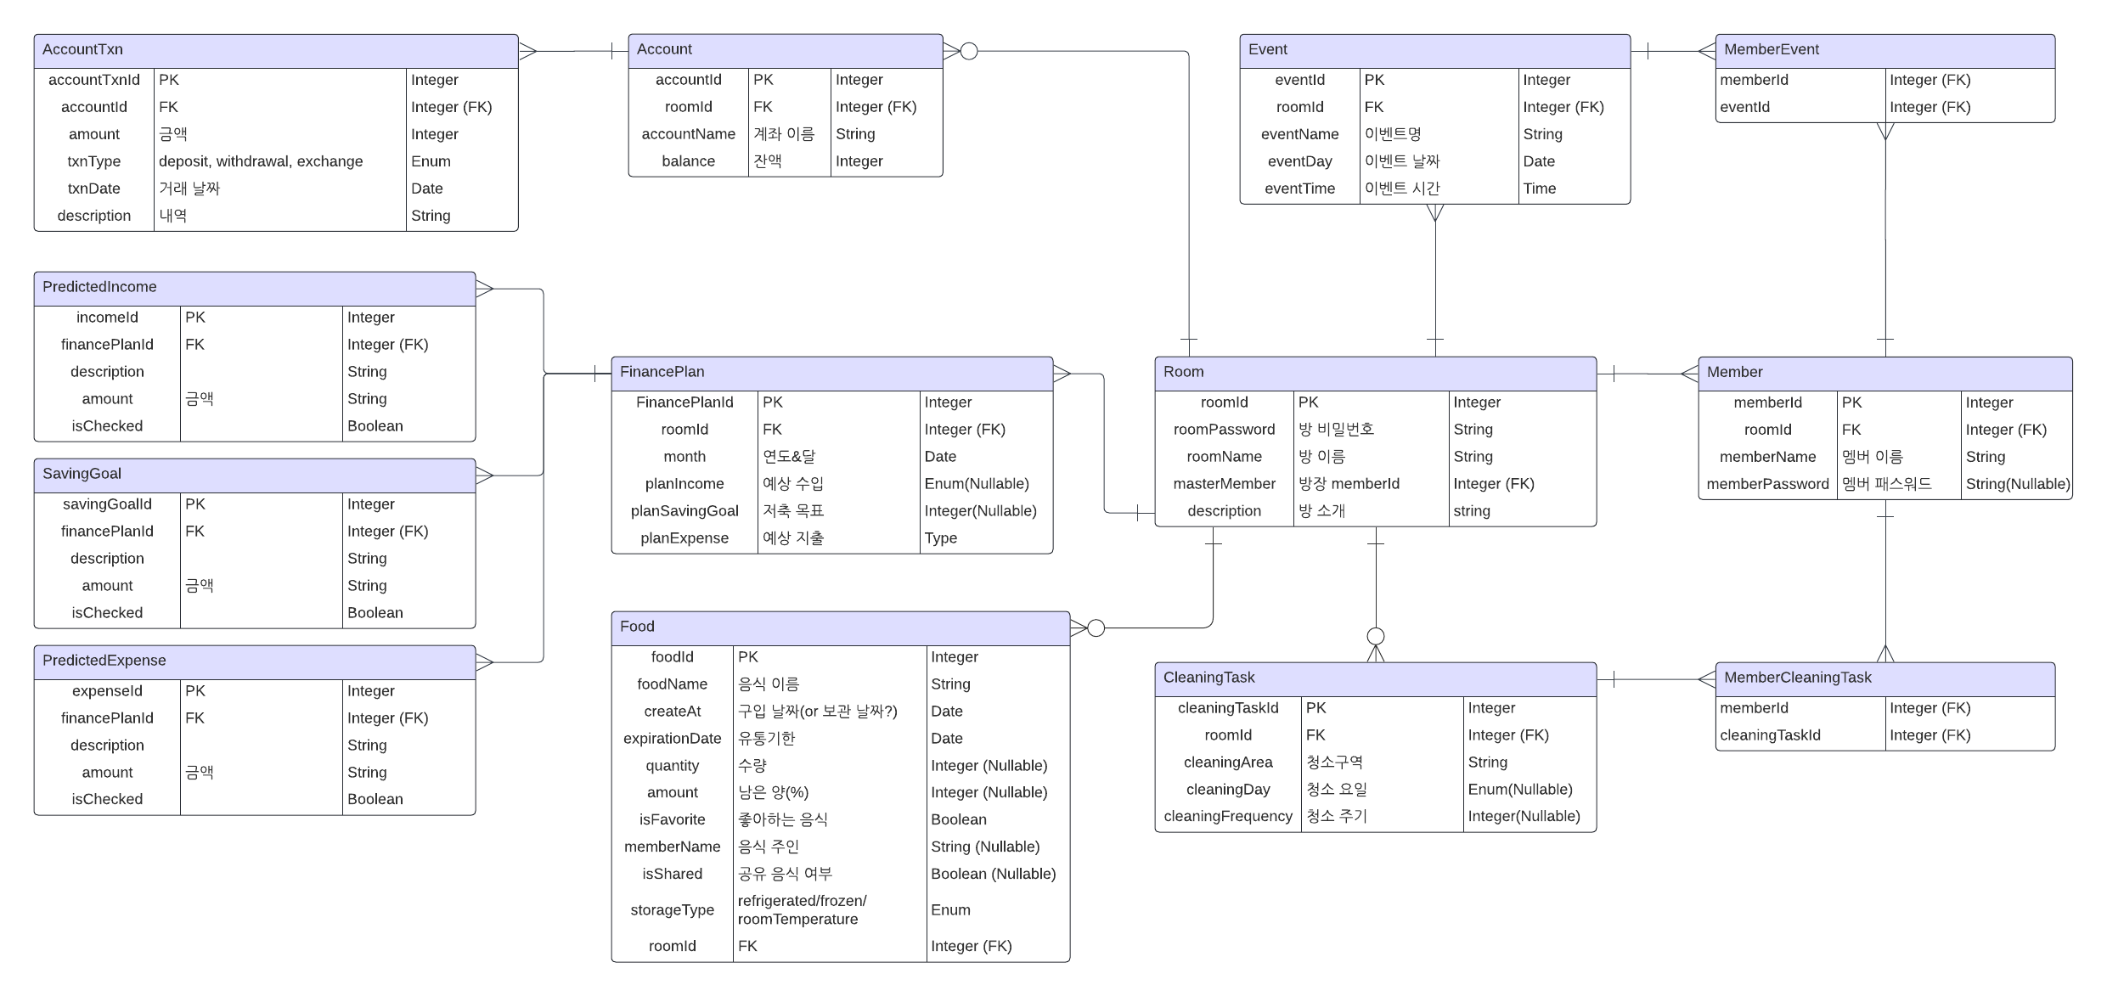
Keep fixing DB Schema + planning to add ‘Setting’ schema.
ERD(Entity Relationship Diagram)

Slide 16
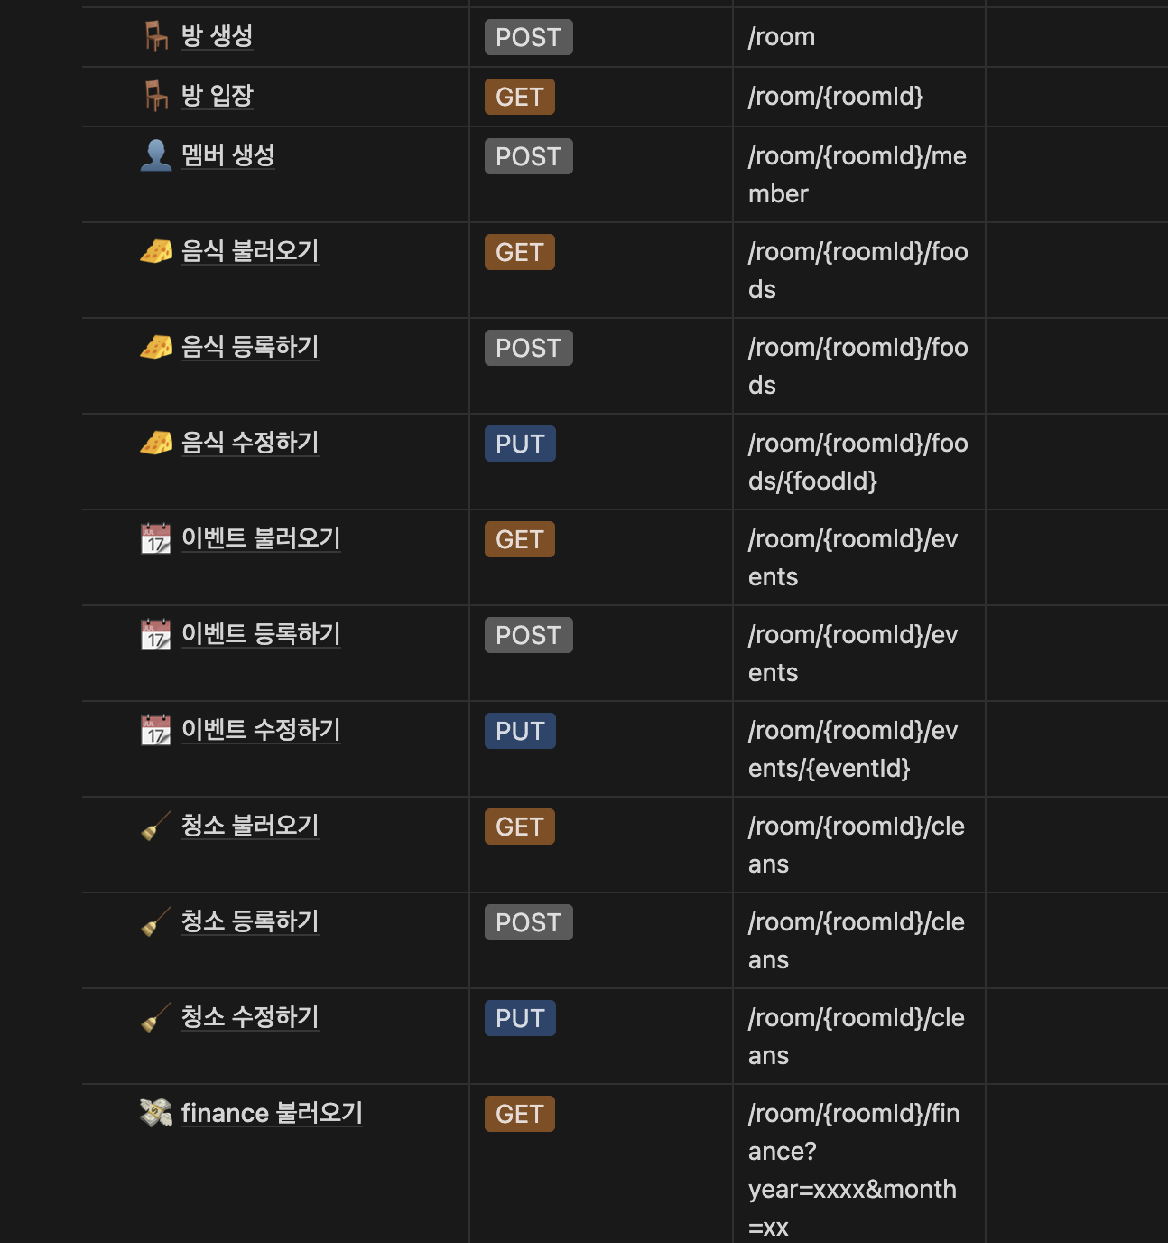
API documentation
- API documentation in Notion -> Considering automation in Swagger while backend Dev.
-> Postman, Swagger

Slide 17







02-03 Frontend & Backend set-up
- @황수영 @최진욱

Slide 18
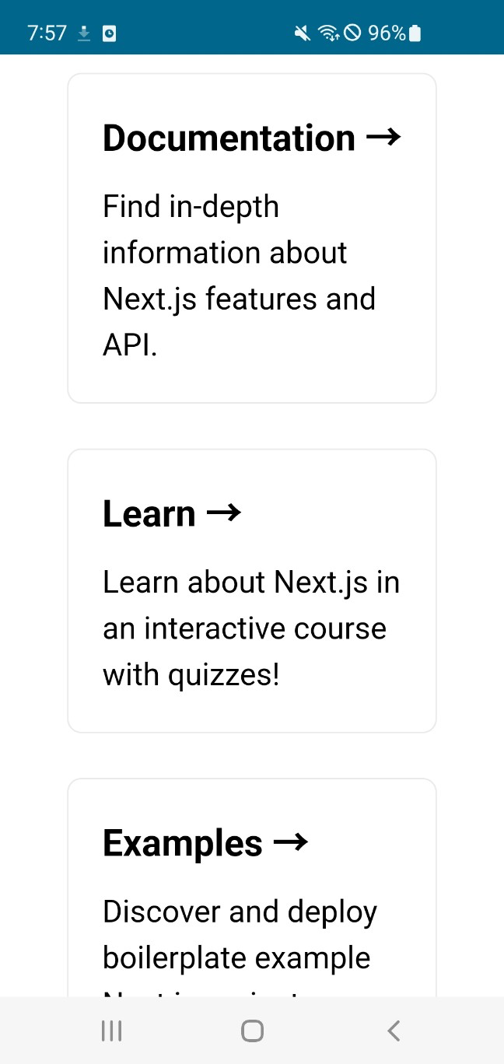
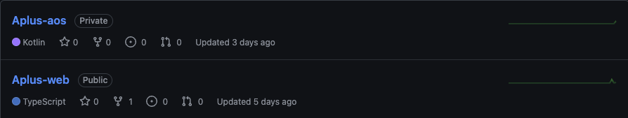
Basic setup @최진욱
Managing with two repositories, Aplus-web for webview and Aplus-aos for app development
Aplus-web: prerequisite packages installed and deployment via Vercel complete
Aplus-aos: Webview setup complete via deployed url, testing simple behaviour with Android phone for testing

Slide 19

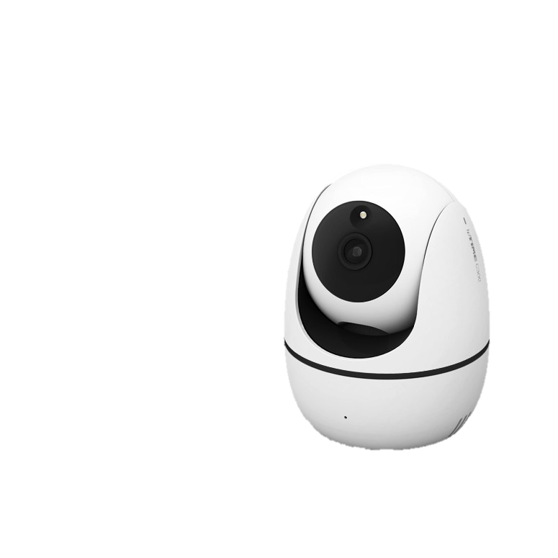

02-03 OCR Feature Implementation- @조서영
{ “foodname” : “서울우유”,
“expirationDate” : ”2024.12.31”}
Spring
-Frame Capture: OpenCv
-Recognition o product name & expiration date:tess4j
(2) Flask
-Frame Capture: OpenCv
-Recognition of product name& expiration date: pytesseract
-Send to Spring server: POST method

Slide 20
Technical Background – OCR
- Grayscale conversion
: each pixel 0 ~ 255
Binary
: convert to only 2 color
- Remove noise
: Gaussian Blurr
- Erosion & Dilation
: adjust thickness
reason: to improve convenience of user
Pre-processing
* ’Tesseract’ :
- High accuracy with LSTM
- Support to more than 100 language(include Korean)
Free software
Train Available(Google Cloud Vison, Amazon Textract X)
Text Detection
CNN
Text Recognition
RNN / LSTM
Post-processing

Slide 21
Problem & Plan– OCR
1. Location of camera
(1) refrigerator(in) => problem : Distinction of product(already recognized or not)
(2) refrigerator(out) => problem: gap between frame capture and recognition of text(also send POST method to Spring server)
2. Period of capturing video frame
3. Check recognition rate of Korean => select best preprocessing method for improve recognition rate
(cutting size of image, grayscale conversion, binary, and so on)
4. Different font and size

Slide 22
03 What will be done
& by whom next week?
Add/Remove/Fix the features of the app @all
Designing the prototype of app with Figma @진서영
Fixing API documentation @황수영 @최진욱 @김민수
Backend @황수영
Frontend @최진욱 -> 디자인 나오는 대로 작업 진행
OCR Feature Implementation @조서영 ->카메라 도착 이후, 환경 세팅 및 프레임 캡처까지 진행 예정

